Slide 1

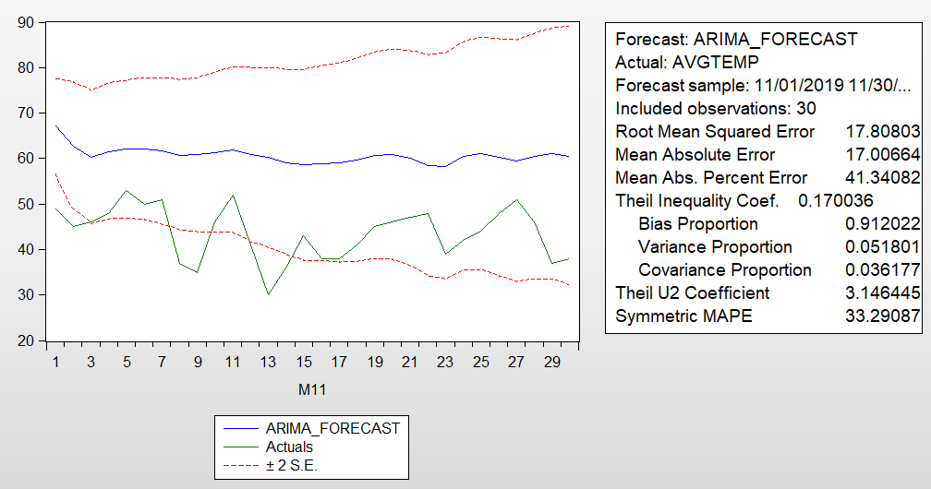
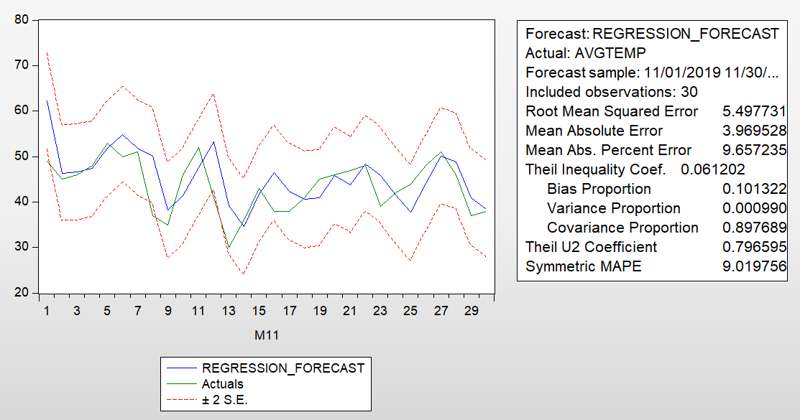
FIN642 Project 2019
Weather Forecast
Group 3 - Akhilesh Yadav Gaddam, and Vinay Gandhi
December 9th, 2019 Drexel University
Abstract
Estimated Results
Conclusion
Seasons, Wind Speed, Air Pressure and Weather Temperature
This project investigates the factors that affect Philadelphia weather temperature and make forecasting for future average weather changes in Philadelphia. Current literature suggests that historical weather are influenced by the Seasons, Air Pressure, and some risk factors. Using daily data for the sample period from 2018/01/01 to 2019/11/30, this project estimates two types of models: time series model and regression model. The time series model is to extract the historical pattern to forecast future Average Temperature changes. The regression model is to link the temperature change to some independent variables. The time series analysis suggests that the Avg Temp change series follows an autocorrelation process with 10 month lag. The evidence from the regression model indicates that the change in temperature is positively correlated with the change in the Q2 & Q3 and negatively correlated with change of average wind speed (-1), average wind direction(-1), average wind speed (-1), and Q1. The root of mean squared error suggests that the regression model (5.498) outperforms the time series model (17.808).
1. Time series (ARIMA) model
The weather time series is not stationary but its first order difference is stationary.
The average daily temperature can be modeled as SARIMA(28, 1, 1) with seasonal order of differencing being 365.
Δ AvgTemp(t) = -0.046 + 0.593 Δ AvgTemp(t-1) - 0.307 Δ AvgTemp(t-2) + 0.125 ΔAvgTemp(t-10)
0.123 Δ AvgTemp(t-28) + 0.098 Δ AvgTemp(t-365) + error(Δ AvgTemp(t-1)) + error(t)
Adj R-squared: 0.21
Our models suggest that quarter/season is the most important predictor of average temperature. Climatory measures of a day can be used to forecast the average temperature of the next day. In this project the regression model performs better than the time series model considering both RMSE and Adjusted R-squared.
Future Work
Average Temperature (°F)
Our time series model and regression model could be used as a basic predictive model for temperature. To move forward, we can invite climatologists, meteorologists, or weather researchers to provide their expertise on what impacts temperature and further improve our models.
In addition, our sample data were from Philadelphia. We can explore different cities and see if the explanatory variables change when the targeted location changes.
2. Regression model
Average Pressure, CDD, Q2 and Q3 are positively related to Avg Temperature while HDD, Avg Wind Direction and Avg Wind Speed are negatively related to Avg Temperature. The model is given as:
AvgTemp(t) = -145.9 + 0.209 AvgPressure(t-1) + 0.873 CDD(t-1) - 0.805 HDD(t-1)
- 0.009 AvgWindDirection(t-1) - 0.332 AvgWindSpeed(t-1) - 1.967 Q1 + 3.575 Q2 + 3.740 Q3
Adj R-squared: 0.91
References
Data sources from The Pennsylvania State Climatologist
What is Air Pressure and How It Affects the Weather: https://www.thoughtco.com/low-and-high-pressure-1434434
Method and Data
Methodology: Time series model vs. Regression analysis
Data Range: 1/1/2018 - 11/30/2019 (Daily)
Sample Period: 1/1/2018 - 10/30/2018 (Daily)
Data Source: The Pennsylvania State Climatologist Daily Temperature
Definition and measure of variables:
Average Temperature (°F) (dependent variable)
Average Pressure (explanatory variable)
Average Wind Direction (explanatory variable)
Average Wind Speed (explanatory variable)
Cooling Degree Days (CDD - explanatory variable)
Heating Degree Days (HDD - explanatory variable)
Quarter of the year (dummy variables)
Average Temperature (°F)
Acknowledgement
We appreciate Dr. Thomas Chiang’s guidance and earlier feedback on our project.

Slide 2
Weather Forecast
Group 3
Akhilesh Yadav Gaddam, Vinay Gandhi
12/09/19

Slide 3

Purpose
Investigate factors that affect weather temperature in Philadelphia
Forecast daily average temperature using available climatic data and daily weather archives

Slide 4
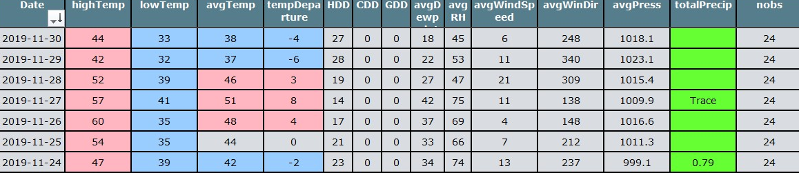
Methodology
Methodology: Time series model vs. Regression analysis
Data Range: 1/1/2018 - 11/30/2019 (Daily)
Sample Period: 1/1/2018 - 10/31/2018 (Daily)
Data Source: The Pennsylvania State Climatologist
Pre-processing the data: Reorder dates and handle missing values

Slide 5
Time Series Model
The weather series is not stationary but its first order difference is stationary
Average daily temperature can be modeled as SARIMA(28, 1, 1) with seasonal differencing of 365.
Model formula:
Δ AvgTemp(t) = -0.046 + 0.593 Δ AvgTemp(t-1) - 0.307 Δ AvgTemp(t-2) + 0.125 ΔAvgTemp(t-10) + 0.123 Δ AvgTemp(t-28) + 0.098 Δ AvgTemp(t-365) + error(Δ AvgTemp(t-1)) + error(t)
Adj R-squared: 0.21

Slide 6
Time Series Model

Slide 7
Regression Model
Q1, Q2, and Q3 converted to dummy variables
IVs from the previous day
Checked correlations and removed the highly related explanatory variables to avoid multicollinearity
Definition and measure of variables:
Average Temperature (°F) (dependent variable)
Average Pressure (explanatory variable)
Average Wind Direction (explanatory variable)
Average Wind Speed (explanatory variable)
Cooling Degree Days (CDD - explanatory variable)
Heating Degree Days (HDD - explanatory variable)
Quarter of the year (dummy variables)

Slide 8
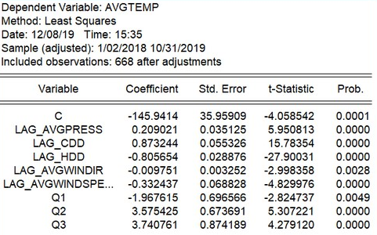
Regression Model
Model formula:
AvgTemp(t) = -145.9 + 0.209 AvgPressure(t-1) + 0.873 CDD(t-1) - 0.805 HDD(t-1) - 0.009 AvgWindDirection(t-1) - 0.332 AvgWindSpeed(t-1) - 1.967 Q1 + 3.575 Q2 + 3.740 Q3

Slide 9
Regression Model
Adj R-squared:
0.91

Slide 10
Conclusion
Quarter/season is the most important predictor of average temperature.
Climatic data of a day can be used to forecast the average temperature of the next day.
Regression model performs better than time series model considering both RMSE and Adjusted R-squared.

Slide 11
Future Work
Invite climatologists, meteorologists, or weather researchers to provide expertise on what impacts temperature to further improve our models.
Explore different cities and see if the explanatory variables change when the targeted location changes

Slide 12
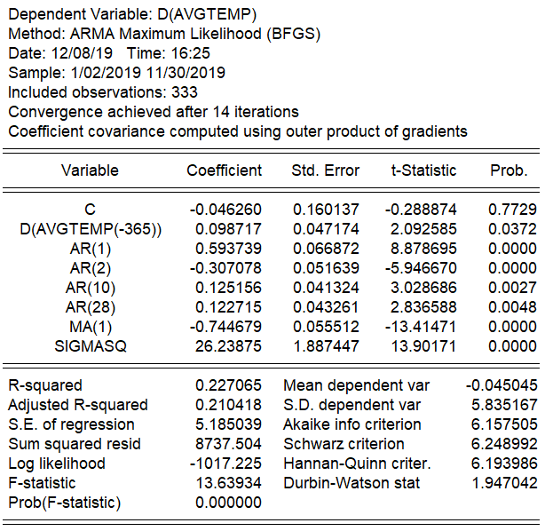
Appendix

Slide 13
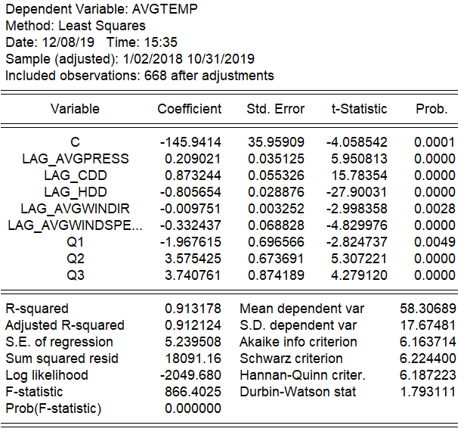
Appendix

